Slide 1
Storyboard for Childcare Pricing Data Mediums
Staci McDuffie
DSC 640: Data Presentation & Visualization
July 13, 2025
Professor Schneider

Slide 2
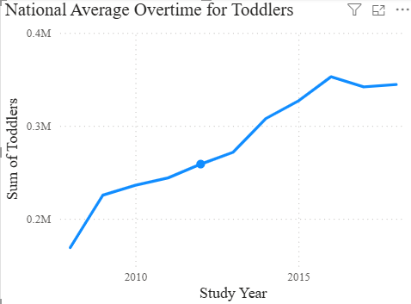
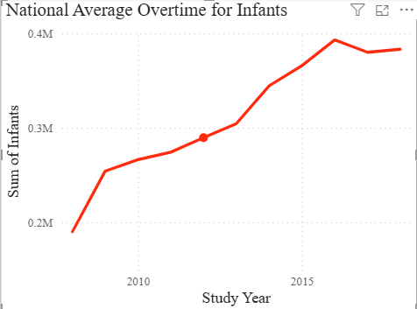
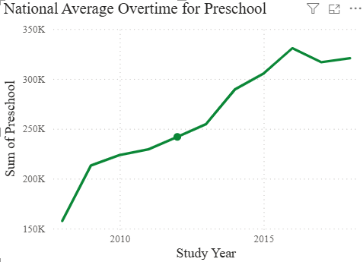
Medium 1: Interactive Dashboard (PowerBI)
Line Charts: Average childcare cost by year

Slide 3
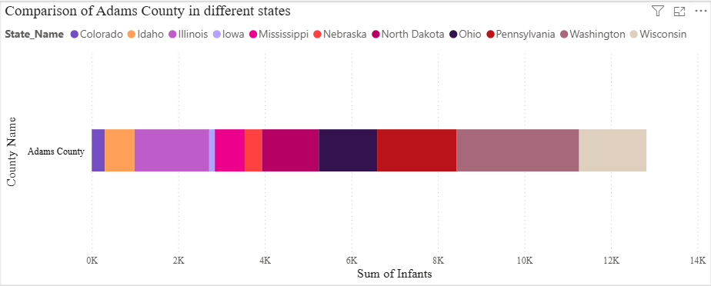
Bar Chart: Comparison of Adams County in different states for infants

Slide 4
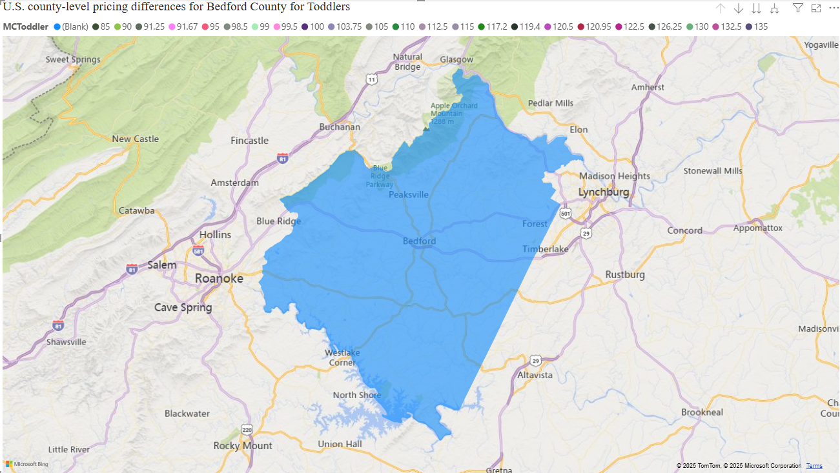
Interactive Choropleth Map: U.S. county-level pricing differences

Slide 5
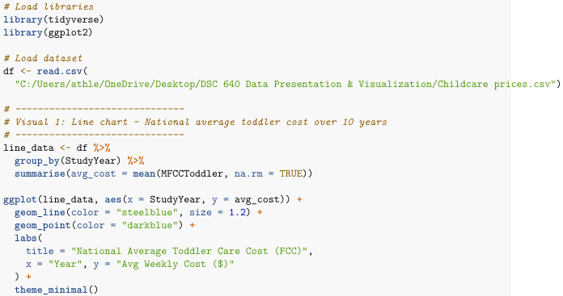
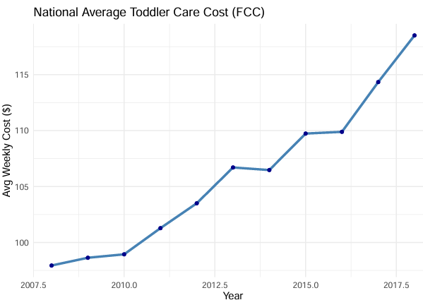
Medium 2: Static Infographic

Slide 6
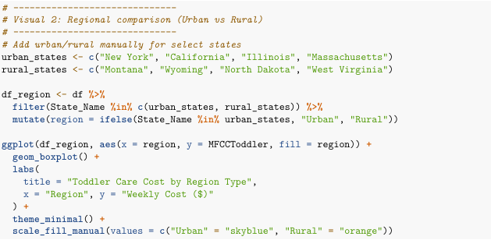
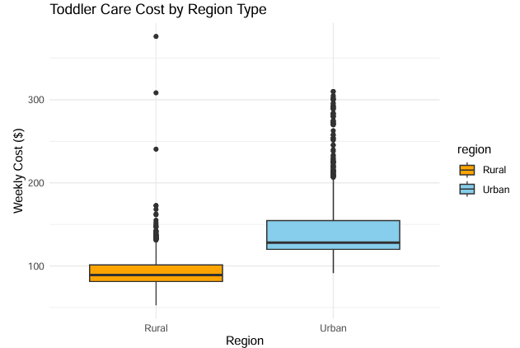

Static Infographic

Slide 7
Policy Brief: The Rising Cost of Childcare in America
Audience: Elected Officials | State Agency Leaders | Education Policy Directors
Key Insights & Visual Summary
The Challenge
Childcare costs in the U.S. have steadily risen, outpacing wage growth in many regions. The lack of affordable care options creates a burden for working
families, disproportionately affecting women, low-income households, and rural communities.
Visual 1: National Trend in Median Weekly Childcare Costs (2008–2021)
Family Child Care (Preschool-Age Children)
A line chart would appear here, showing a steady increase from ~$120/week in 2008 to ~$180/week in 2021, with sharper growth post-2016.
Visual 2: Geographic Cost Inequities
Choropleth Map – U.S. County-Level Preschool Childcare Costs (2021)
  Darker regions show higher median costs (>$200/week) in coastal and metro areas
  Lighter regions reflect lower costs (<$100/week) in parts of the Midwest and rural South
Key Findings:
Over 85% of U.S. counties saw increases in childcare costs between 2008 and 2021.
Urban counties face median preschool costs upwards of $230/week, while some rural counties report below $90/week.
Low-income households often spend 20% or more of their income on childcare.
Supply shortages are most pronounced in infant care and rural areas.
Counties with high childcare costs tend to have lower availability of licensed providers.

Slide 8
Policy Brief: The Rising Cost of Childcare in America Cont.
Implications & Recommendations
Why It Matters
  Workforce Participation: Rising childcare costs force families—especially mothers—to reduce hours or leave the workforce.
  Educational Gaps: Inconsistent care access delays early learning, disproportionately impacting low-income and minority children.
  Economic Recovery: The childcare industry is foundational for a functioning economy post-pandemic.
Policy Recommendations
  Expand Subsidy Programs
  Increase funding and eligibility for Child Care and Development Fund (CCDF).
  Target subsidies toward infant care and underserved ZIP codes.
Incentivize Provider Expansion
  Offer tax credits and grants for new providers in childcare deserts.
  Support rural and family-based providers with infrastructure and licensing support.
Enhance Data Transparency
  Mandate annual reporting of local childcare costs and availability.
  Invest in accessible dashboards for policymakers and parents.
Build Public-Private Partnerships
  Encourage employer-supported childcare programs.
  Leverage school districts and libraries for preschool site expansion.
Ensure Equity in Access
  Prioritize services in marginalized communities.
  Address cultural and language barriers in provider networks
  ChildcareEquity.gov | childcare-policy@us.gov
  Prepared with data from the U.S. National Database of Childcare Prices (2019–2023)

